Slide 1
CPS 109 - Lab 5

Slide 2
Agenda
Last lab was functions. This lab, let’s talk about recursive functions. We will also talk more about mutability and tuples.
I know some of you have encountered “classes” with testing. We will go over that next week.

Slide 3
Recursive Functions
What’s a recursive function? Well, first let’s talk about what it means to be recursive.
For something to be recursive, it has to reference itself in order to work.

Slide 4
Recursive Functions
In all seriousness, for something to be recursive, it has to call on itself in order to work.

Slide 5
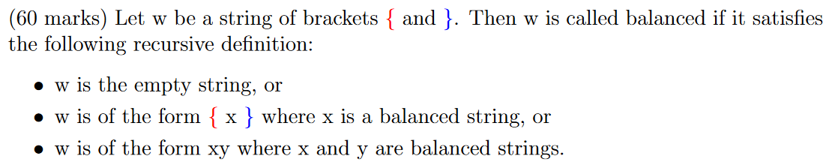
Recursive Definitions
Let’s look at an example from an assignment I was given last year:

Slide 6
Recursive Functions
So what does this mean to you? Well, we can use this concept to write functions!

Slide 7
Recursive Functions
Why would this ever be useful? Well, there are some instances where recursion is the only way to solve a problem.
Can any of you think of a problem that may require recursive functionality?

Slide 8
Base Cases
First, however, we need to talk about base cases. These are super important for designing recursive functions, since they keep your program from recursing indefinity.

Slide 9
Base Cases
What is a base case?
Simply put: it’s the default behaviour you need to account for when writing a recursive function. Base cases are reserved for when the function’s input is very simple, like 1.

Slide 10
Recursive Functions
One application that you guys have already gone over is the Fibonacci sequence. Another one we can approach with recursion is factorials.

Slide 11
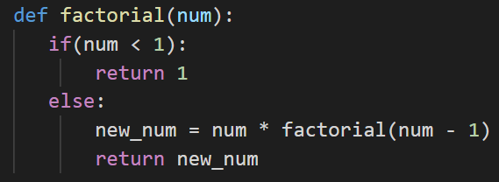
Recursive Functions

Slide 12
A Word On Mutability
We have touched upon mutability in the past, but let’s get a concrete understanding of it.

Slide 13
A Word On Mutability
Something is mutable if its contents can be changed (like a list).
Something is immutable if its contents cannot be changed (like a string or a tuple).

Slide 14
But What’s A Tuple?
A tuple is an immutable list! It is ordered. What does that mean?
Just like a list, you can access members of the tuple by using their index. The difference is that you cannot change a tuple!

Slide 15

Tuple Example
Tuples need round () brackets, instead of the conventional square [] brackets for lists.
You can iterate over them just like lists and strings!

Slide 16
But what about str.replace()?
You’ll notice that for string manipulation methods (.replace(), .lower(), etc.) the method returns a new string.
You need to overwrite your old string with the new string returned by the method.

Slide 17
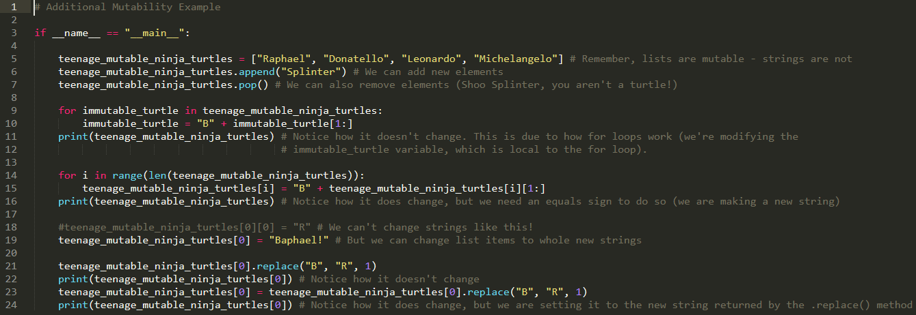

Mutability Example 2

Slide 18
Questions?

